Slide 1
Daily Activities
Hayleigh Davis

Slide 2
Personal Hygiene
Helu ulu: brush hair
Vali vali mata: put on makeup
Tui vala: get dressed
Tele va’a: shave legs
Fakamingimingi ‘ulu: curl hair
Fakahika ‘ulu: straighten hair
Ngaahi ‘ulu: do hair
‘ai ‘otolono: deodorant
Milimili: lotion
Fufulu nifo: brush teeth
Kaukau: shower
Tafitafi: only wash face, arms, and legs
Fakamomoa ‘ulu: dry hair
Fi ‘ulu: braid hair

Slide 3
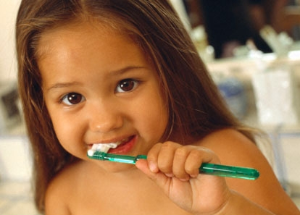
‘Oku ou fie fufulu nifo.
I want to brush my teeth.

Slide 4

‘Oku ou sai’ia milimili.
I like lotion.

Slide 5
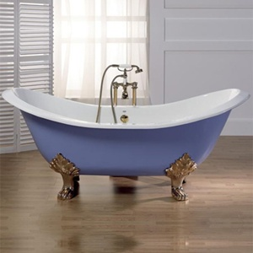
Kuo u ‘osi kaukau au.
I have already take a bath.

Slide 6
Activities
Kai: eat
Va’inga: play
Sio faiva: TV
Neti: computer
Ako: study
Ngaue: work
Talanoa telephoni: talk on the phone
Mohe: sleep
Eva: hang out
Fakatau: shopping
Maumau taimi: waste time
Lau tohi: read

Slide 7
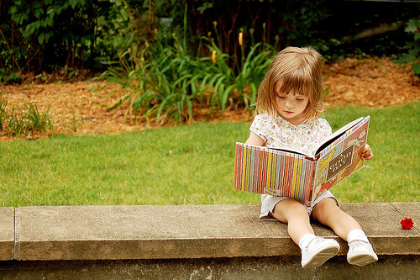
‘Oku ou sai’ia lau tohi.
I like to read.

Slide 8
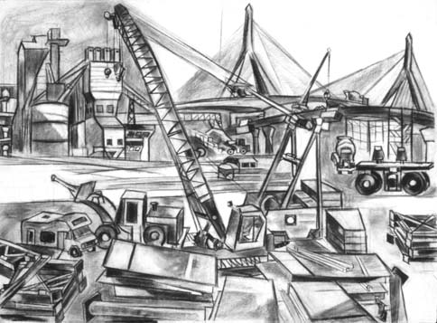
‘Oku ou ‘alu ki he ngaue.
I am going to work.

Slide 9


‘Oku ou ako fika.
I am studying math.

Slide 10
Hobbies
Paint: ta vali vali
Laukonga: reading
Mutu lau: gossip
Lele: run
Hiki hiki: lift weights
Kakau: swim
Kaka mo’unga: hike mt.
Heka vaka: boating
Siki: ski
Fanifo: surf
Hika pasikala: biking
Faita: photography
Me’a fait: camera
Fangota tau: look for seashells
Tau matau: fishing
Uku: diving
Kaka maka: rock climbing

Slide 11

Ko e fai ‘eku fangota.
I am fishing

Slide 12

Ko e fai ‘eku lele.
I am running.

Slide 13
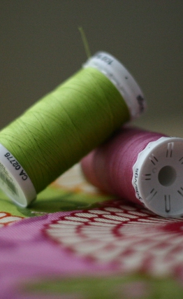
Ko e fai ‘eku tuitui.
I am sewing.

Slide 14
Responsibility
Faka ma’a fale: clean house
Pelu fo: fold clothes
Fo: washing/laundry
Ave e veve: take out trash
Ngaahi ngaue: gardening
To matalei akau: flowers plant
Fufulu me’a lelei: wash car
Fufulu matapa sio ‘ata: wash windows

Slide 15
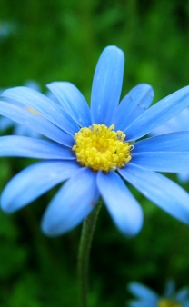
Ko e fai ‘eku to kakala.
I’m planting a flower.

Slide 16
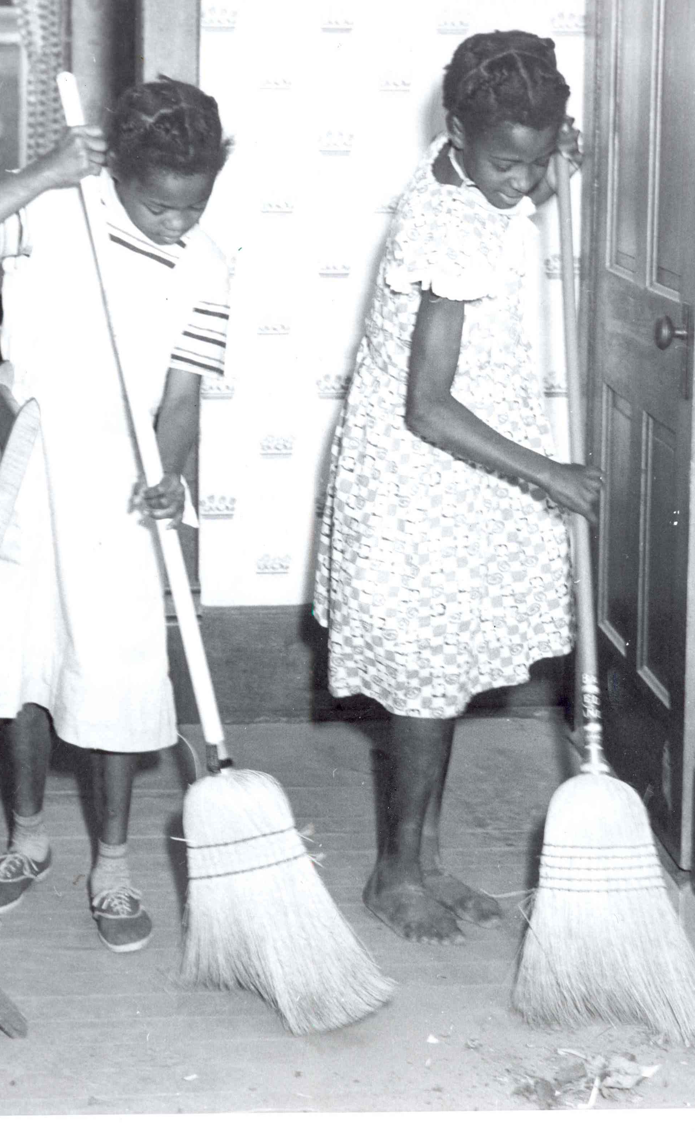
Na’e fai ‘eku tafi.
I was sweeping.

Slide 17
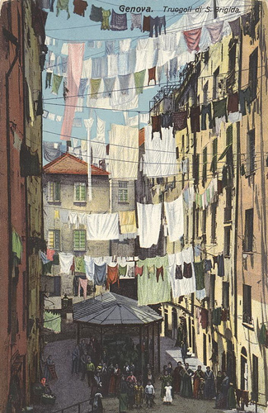
Na’e fai ‘eku fo.
I was washing clothes.

